Slide 1

Scalable AI for Good in Genomics and Health
February 11, 2022 | Colby T. Ford, Ph.D.

Slide 2
Overview
About Me
AI Advancements
Structure Prediction
Cloud Scalability
Explainable ML
Impacts
Drug Discovery
Public Health
Designing Diagnostics

Slide 3
With advancements in cloud computing and AI technologies, we can now explore the complexities of disease diagnostics and prevention, innovate on new therapeutics, and investigate the severity of evolving issues such as COVID-19, all without setting foot in a lab. In this talk, we will walk through the in silico ways we’re tackling these issues using cloud-based machine learning at-scale.

Slide 6
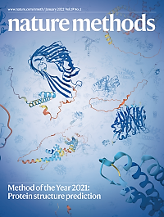







Advancements That Make This Possible…
Protein Structure Prediction
(AlphaFold2 and RoseTTAFold)
Cloud Scalability
(Kubernetes, Docker,
Spark, CUDA, etc.)
Automatable/Explainable AI
(AutoML, Ensemble Learning,
SHAP, etc.)

Slide 8
Malaria Vaccines and Diagnostics using Sequence and Structural Analysis
🦟💉
Dieng and Ford et al. (2021) doi: 10.1101/2021.12.29.474460

Slide 9
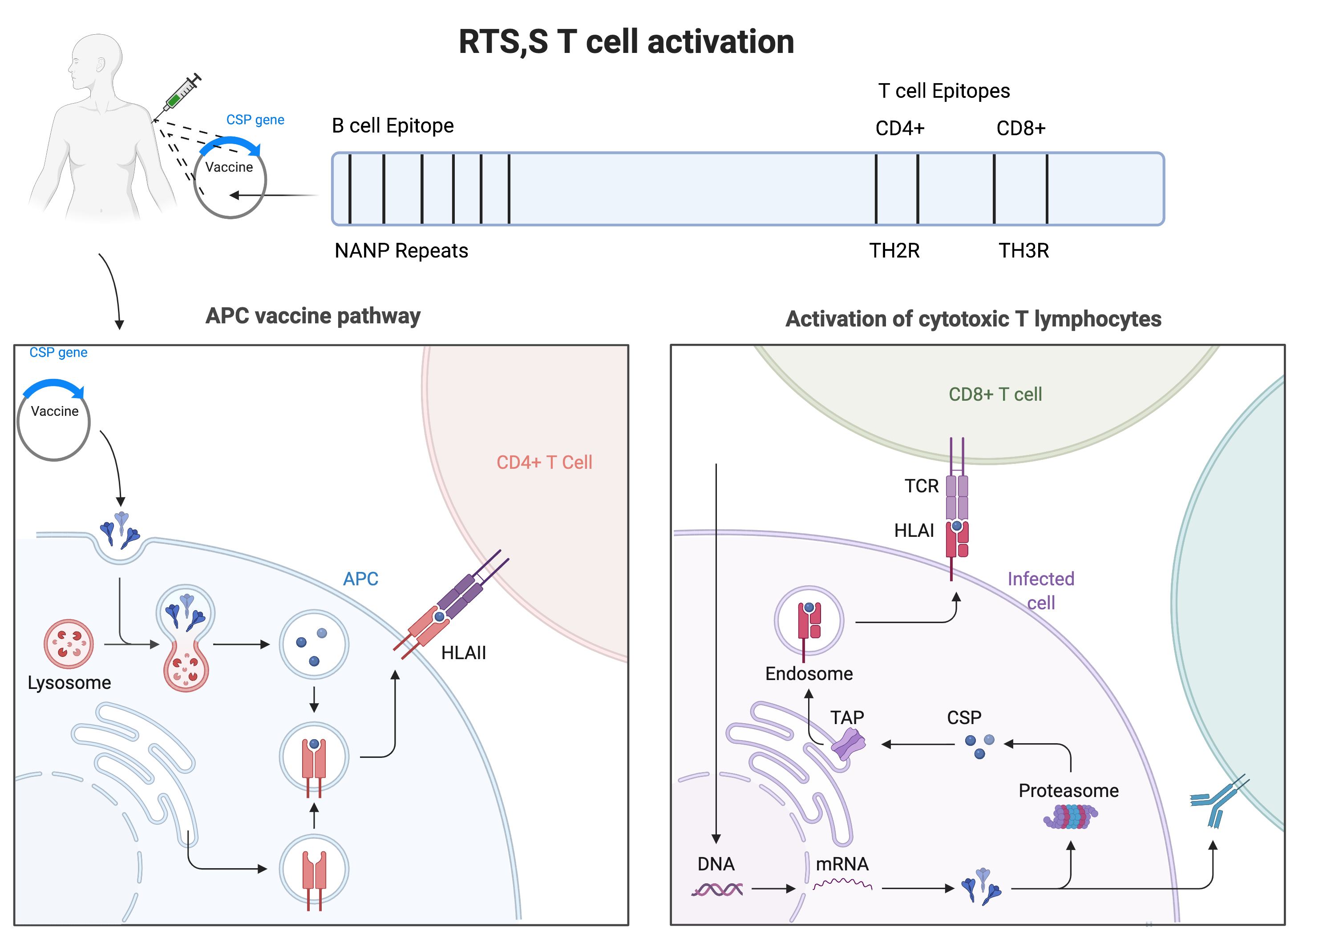
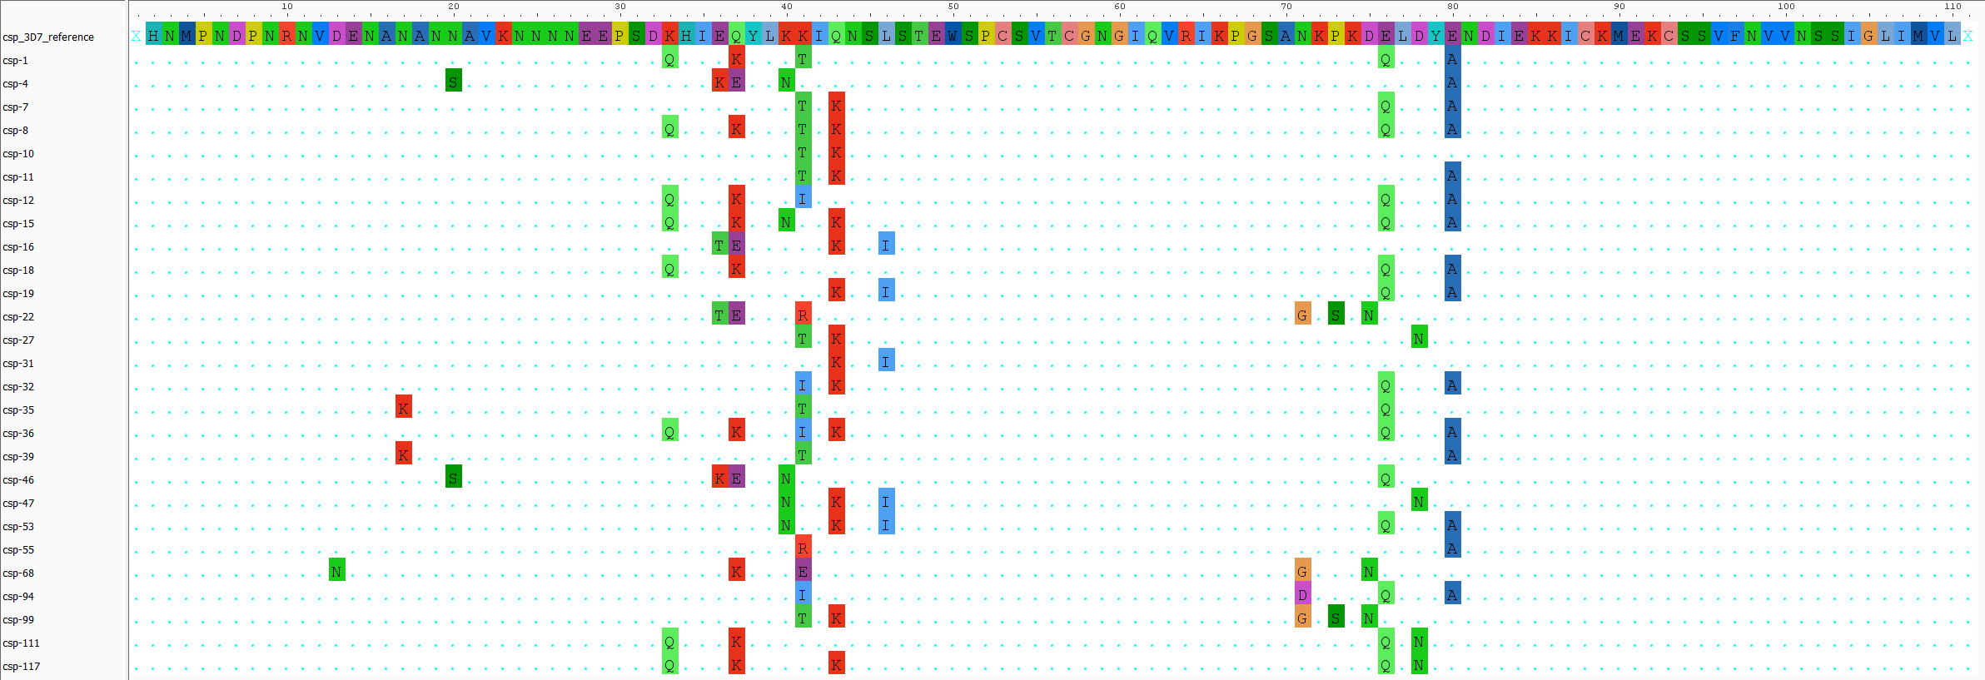
The Problem
Vaccine Efficacy Woes
CD4+
CD8+
The RTS,S vaccine, in Ghana, has a low efficacy (~30%).
The RTS,S vaccine is based on the Plasmodium falciparum 3D7 reference Circumsporozoite Surface Protein (PfCSP).
None of our Ghanaian isolates (haplotypes) matched 3D7.
See where I’m going with this?
HLA-II
HLA-I
Lysosomal
Degradation
Proteasomal
Degradation
Th2R
Th3R

Slide 10

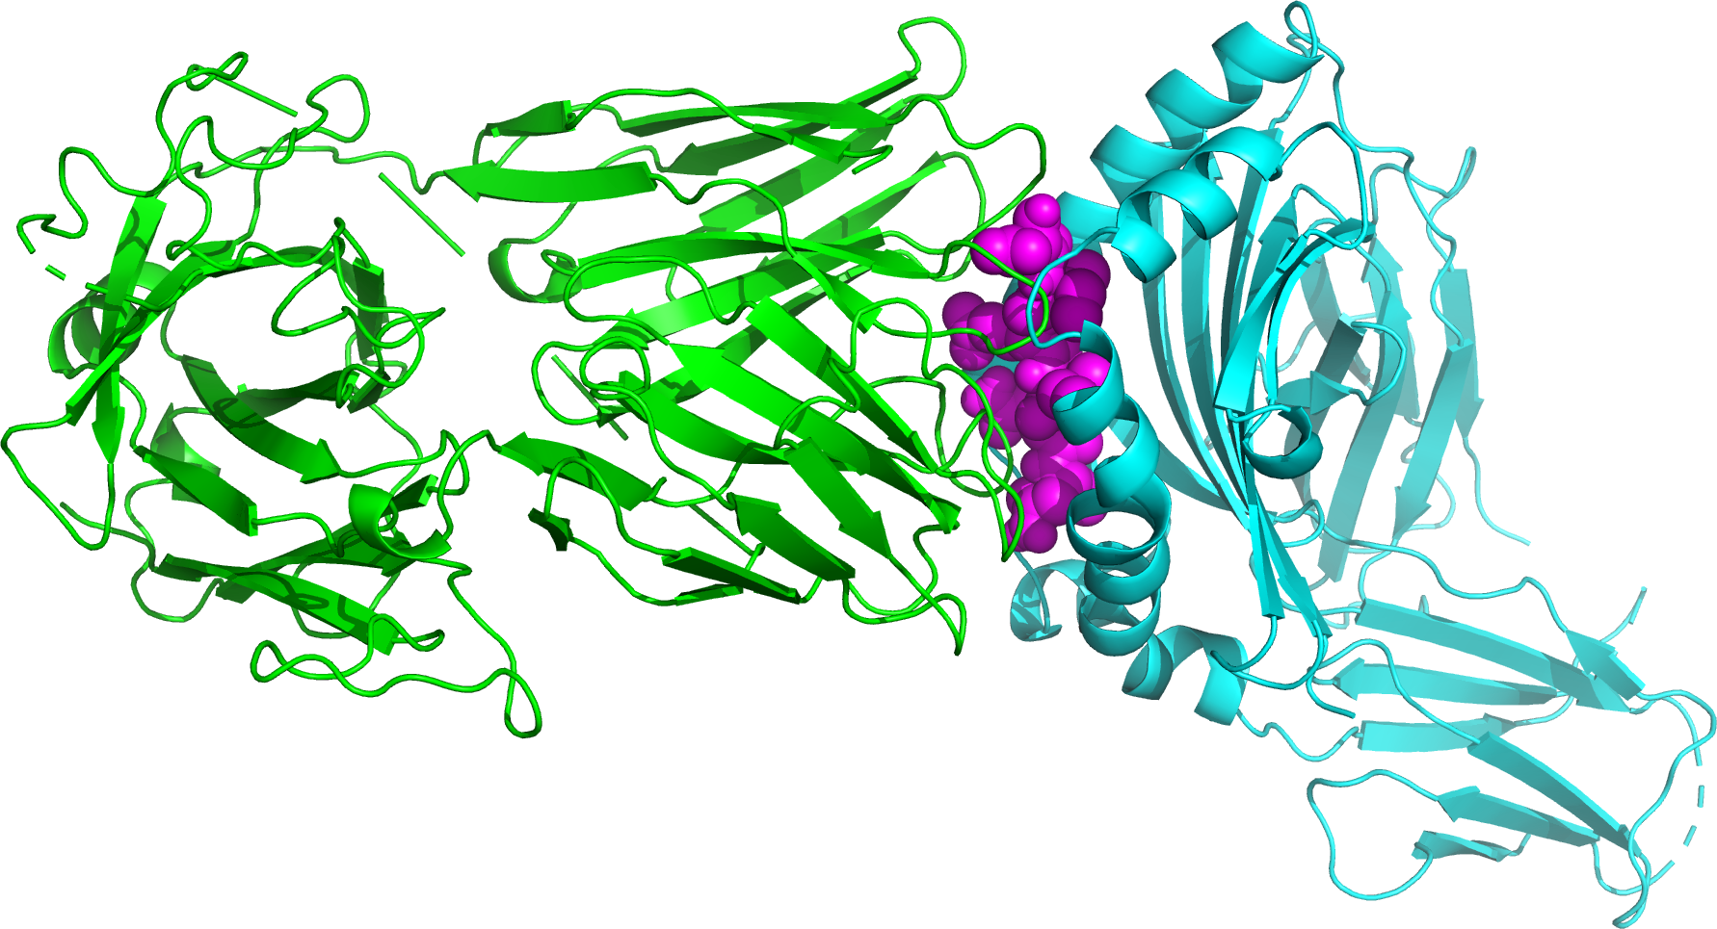
Our Investigation
Find
SNP-based Haplotypes
Filtering and Alignment
CSP Haplotype:
CSP Peptide:
Find CSP Haplotypes
(using HaplotypR)
Filter CSP Haplotypes
Append Reference Sequence
Align Haplotypes to Reference
Docking:
Simulate Degradation and Predict Structure
Protein-Protein Interaction, Docking, and Comparison
TCR
CSP
HLA
Predict CSP haplotype
peptide structures
(using NetChop and PeptideBuilder)
Predict binding affinity between
HLA, CSP peptide, and TCR
(using HADDOCK) and compare

Slide 11
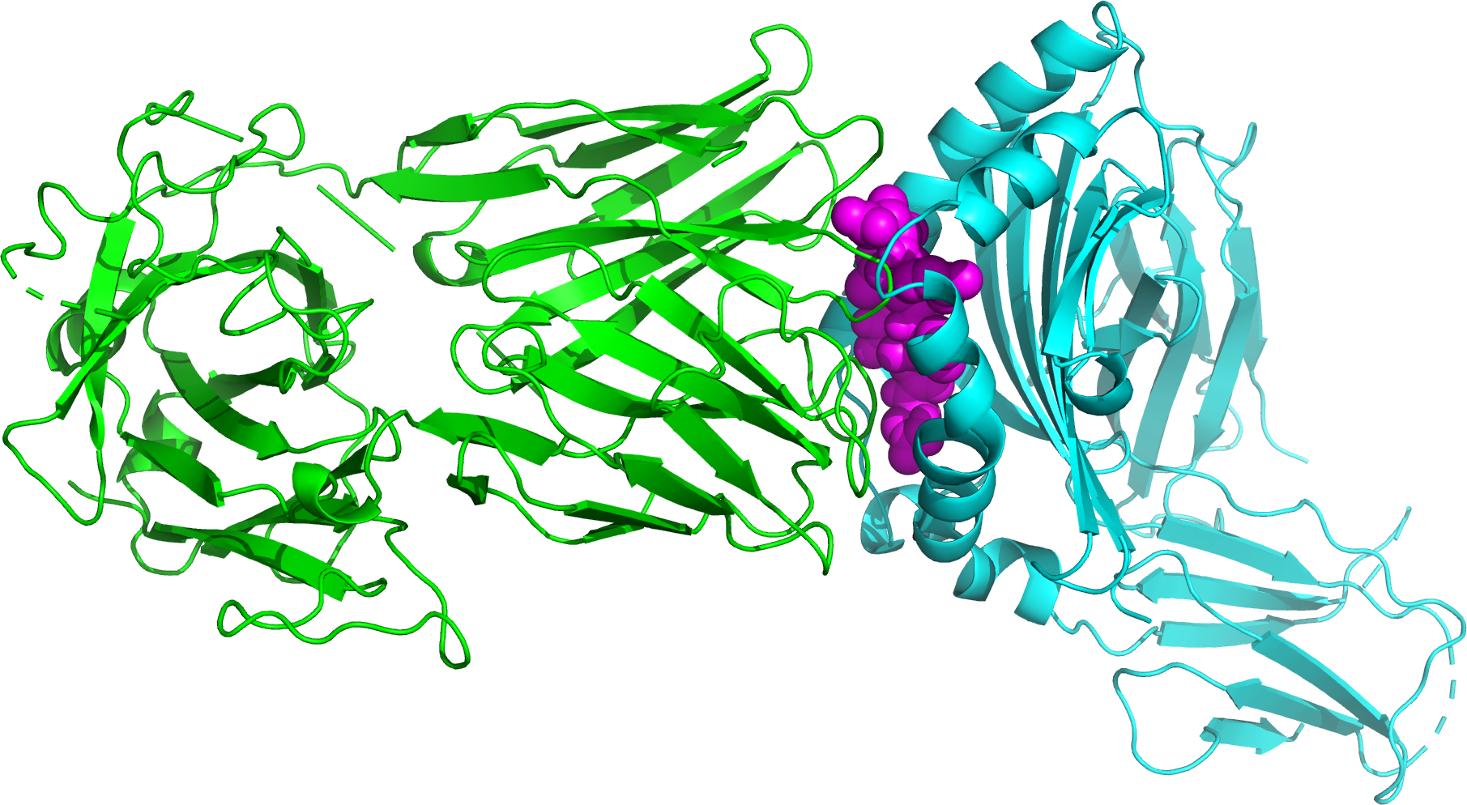
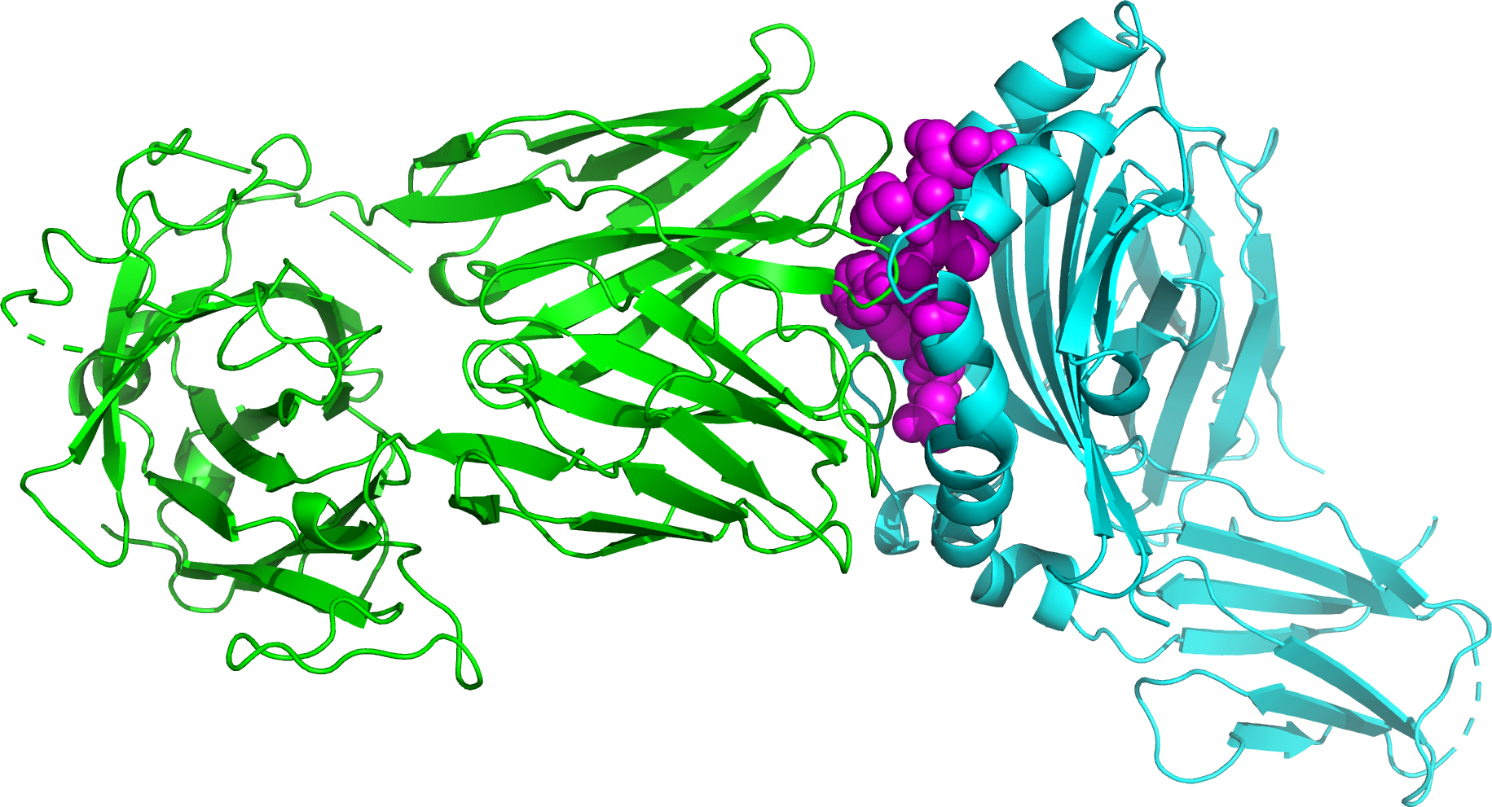
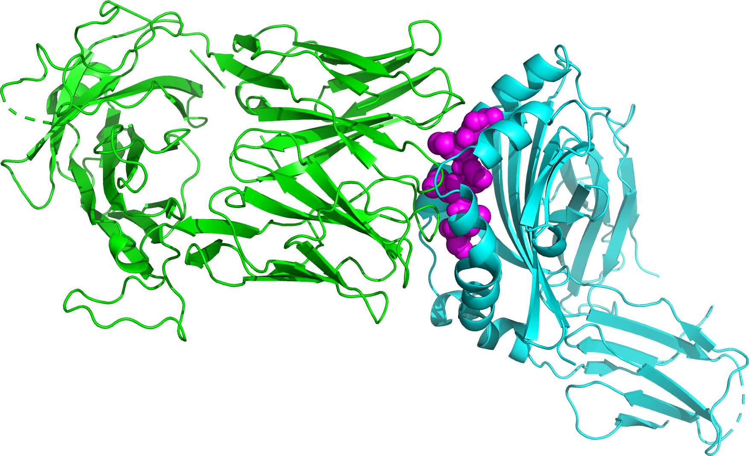
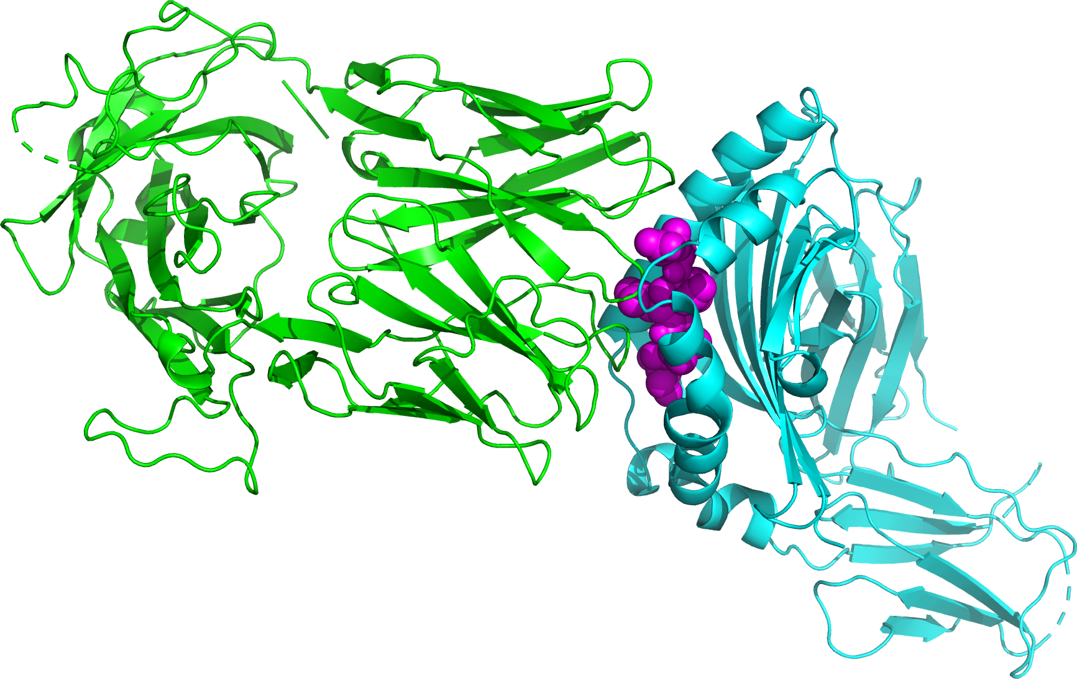
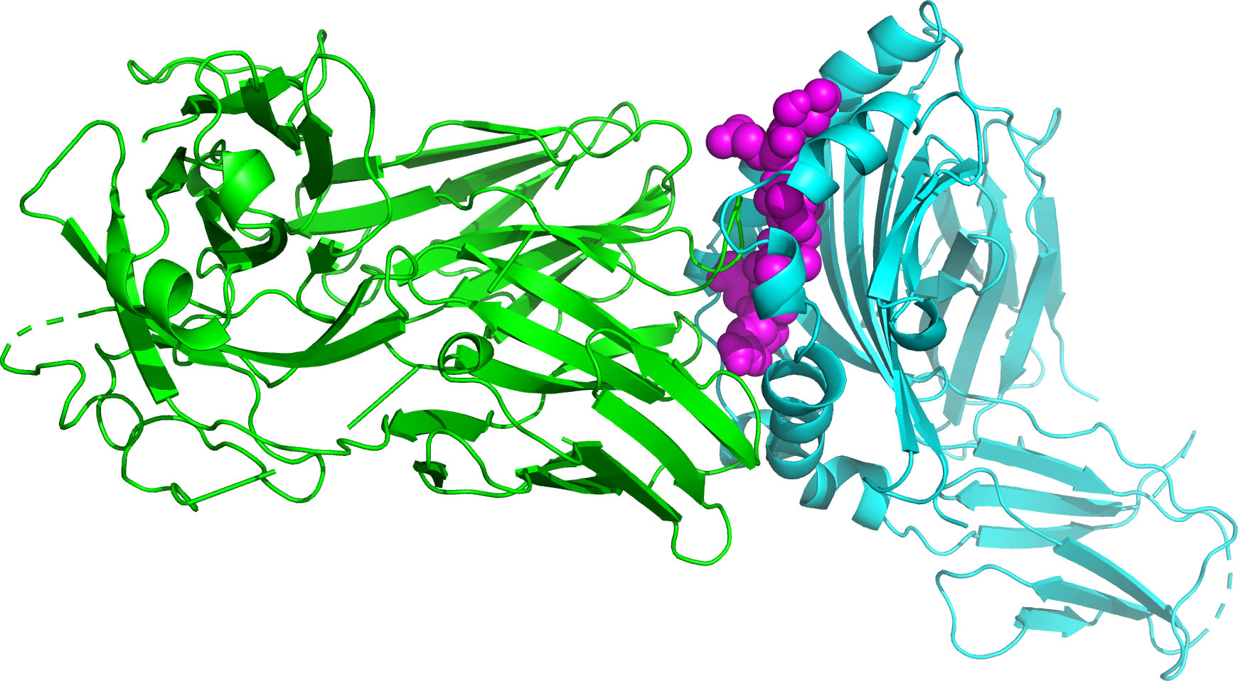
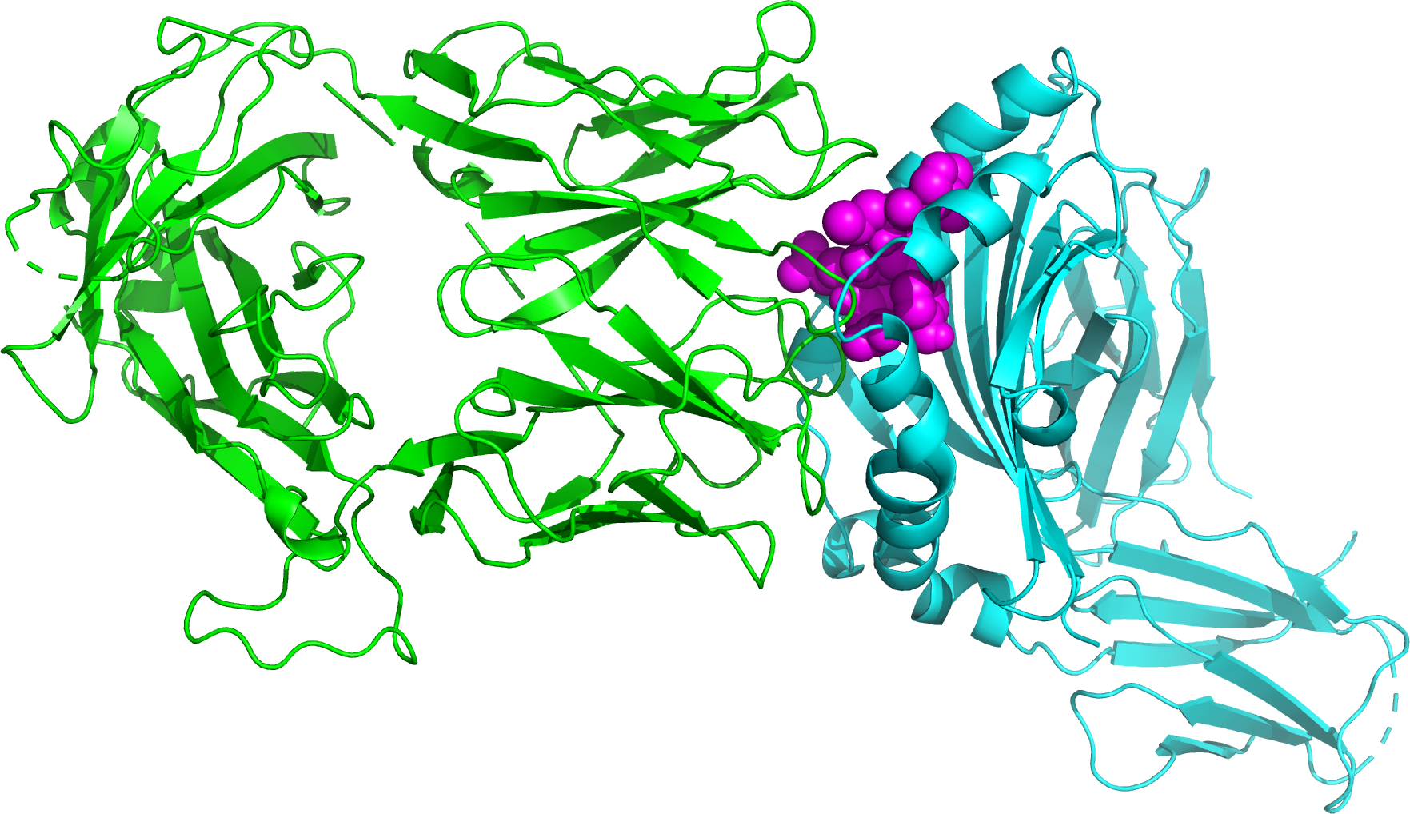
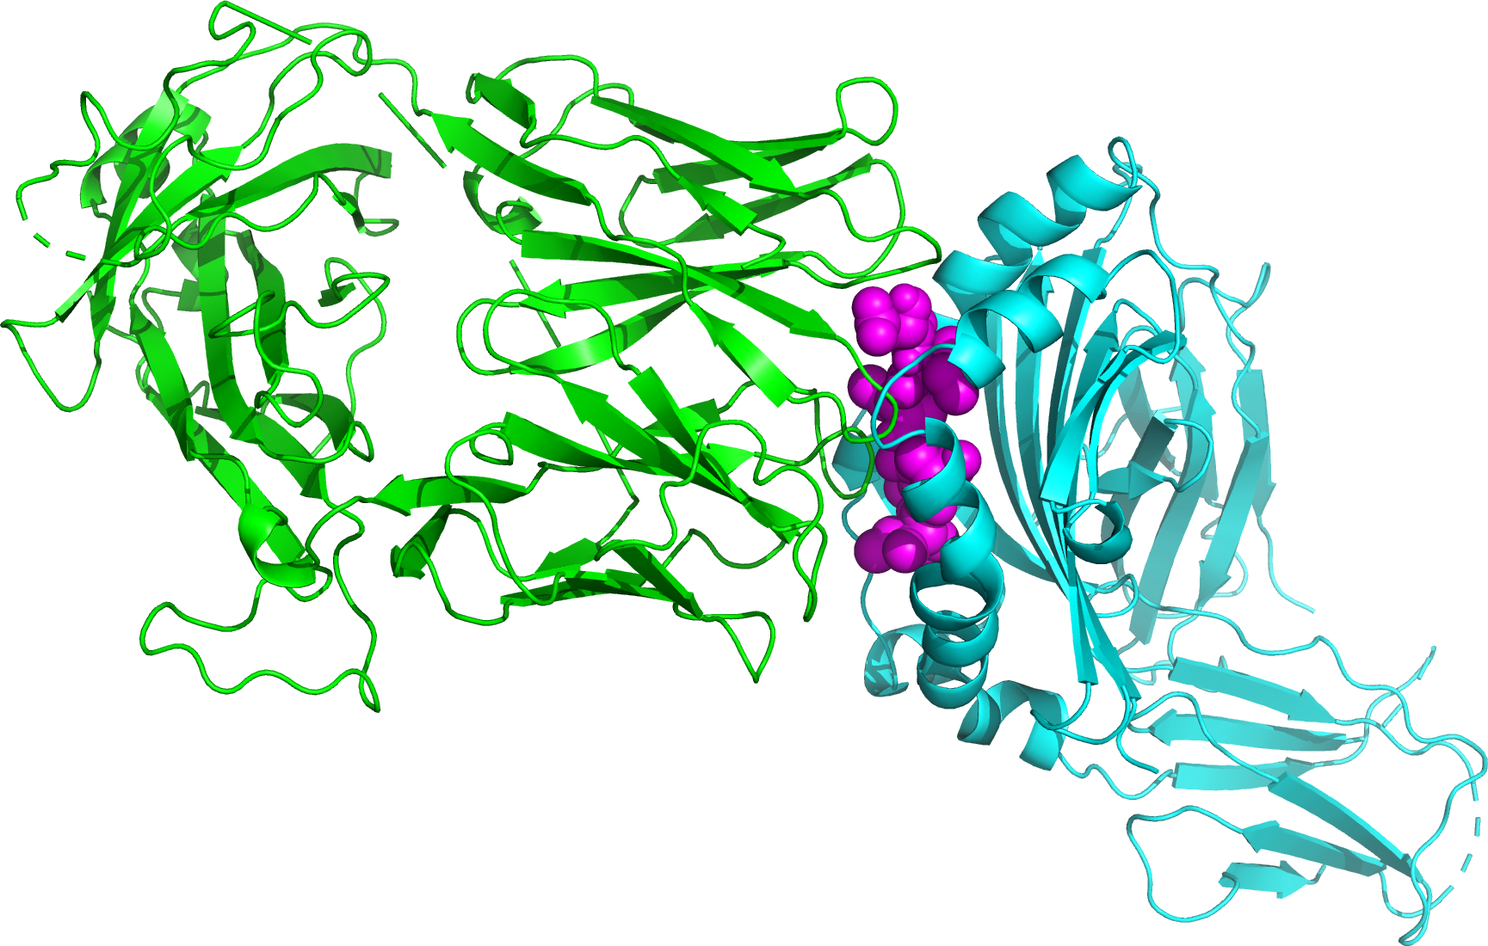
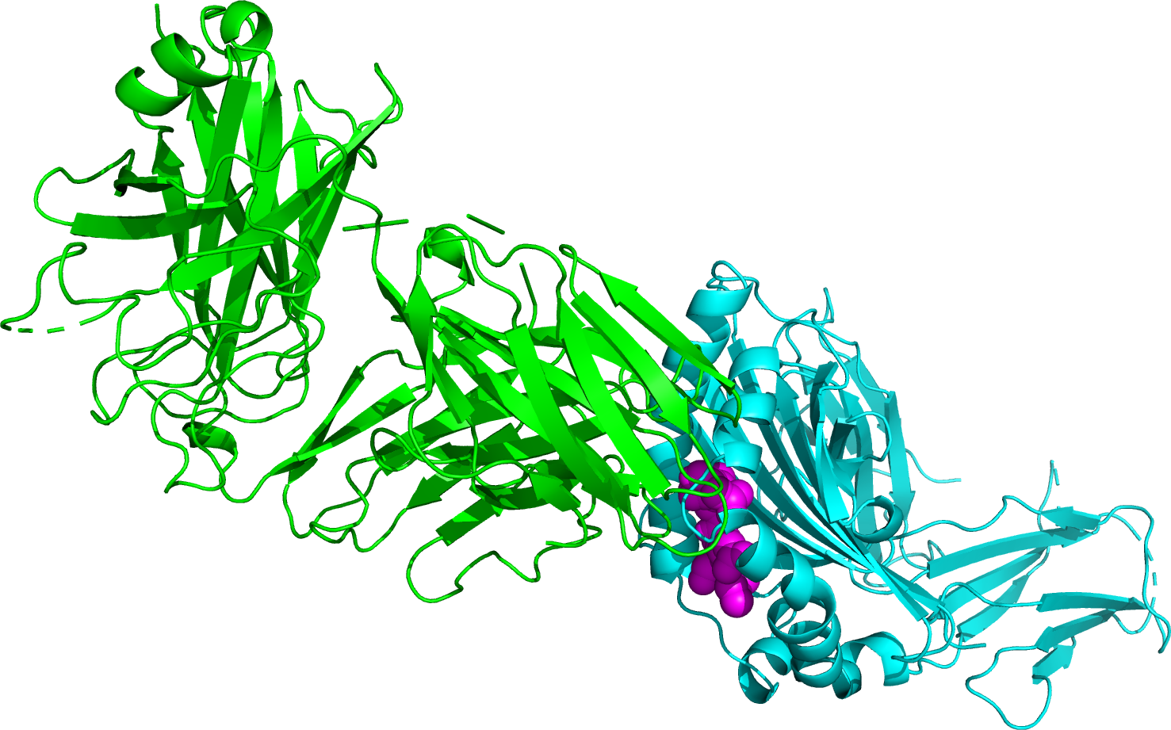
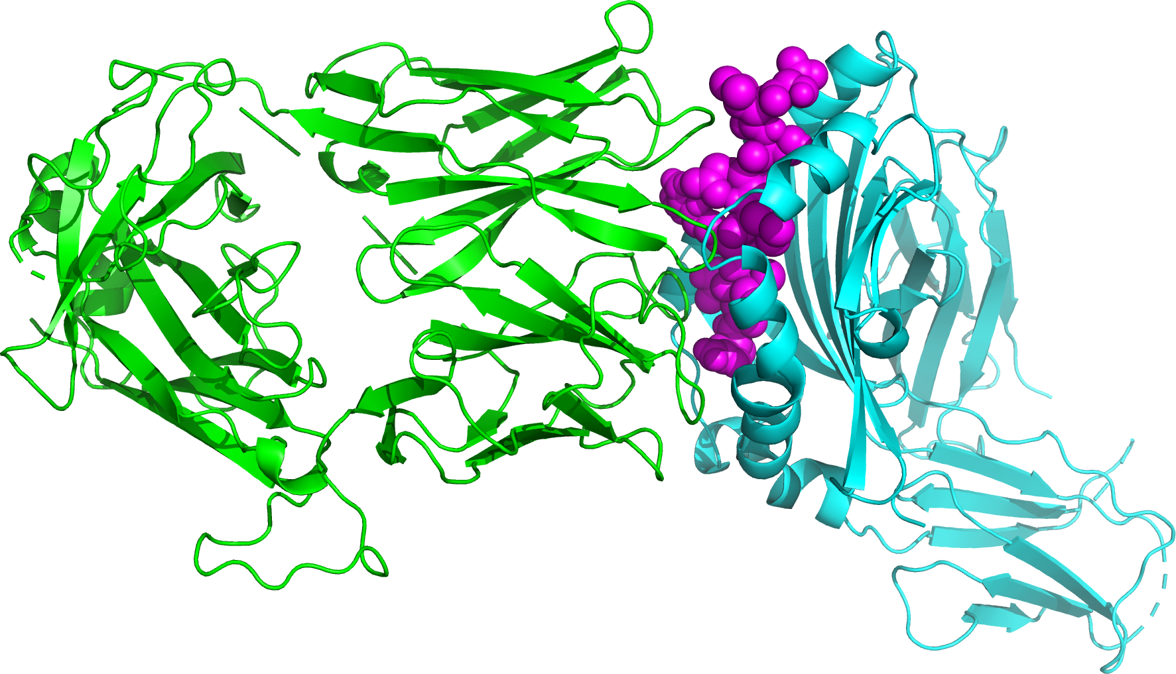
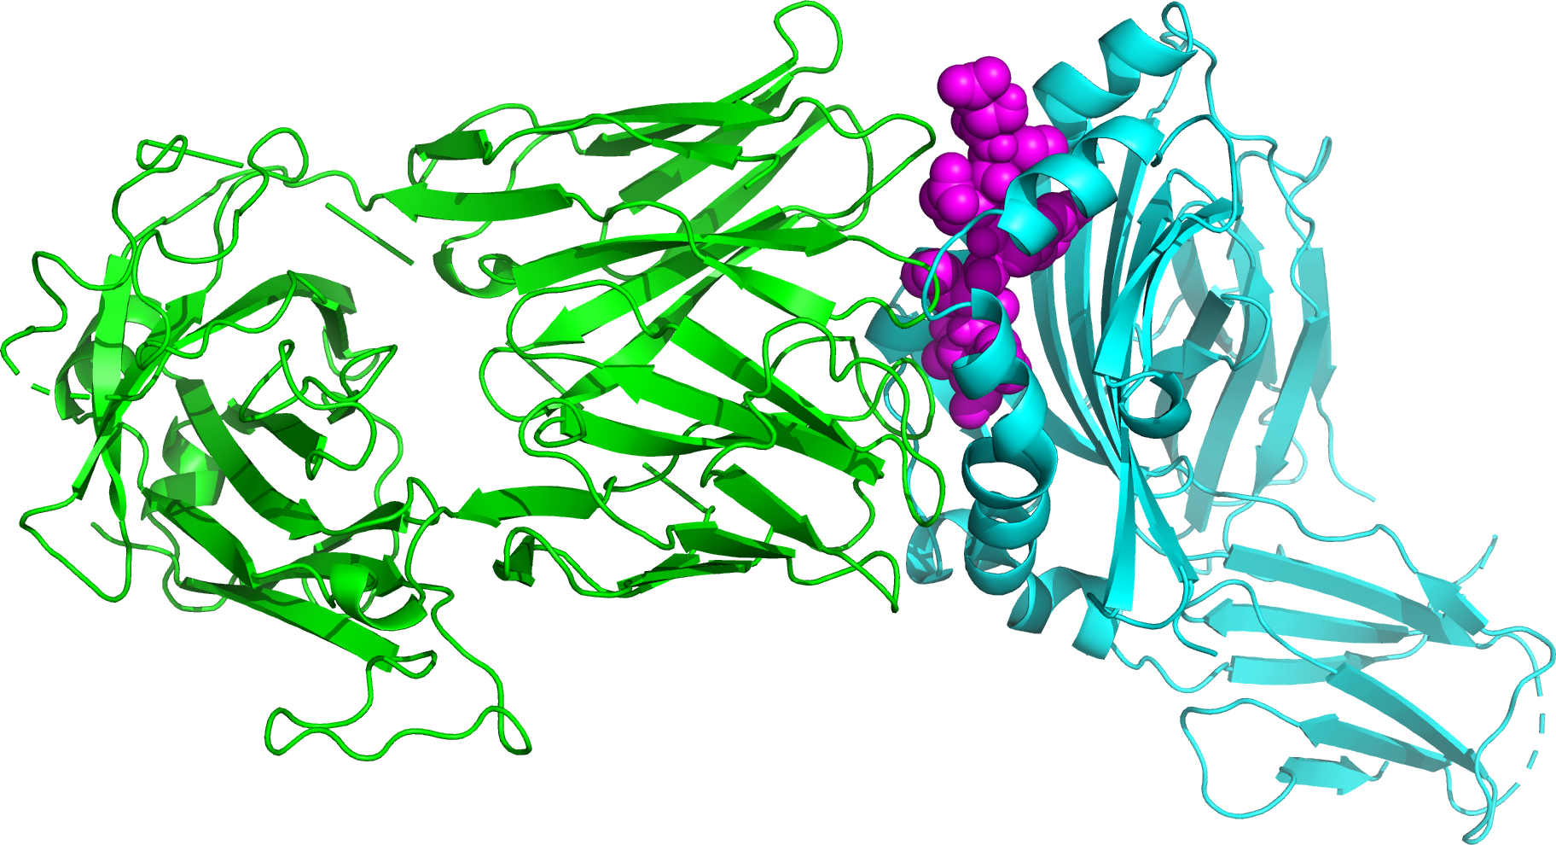
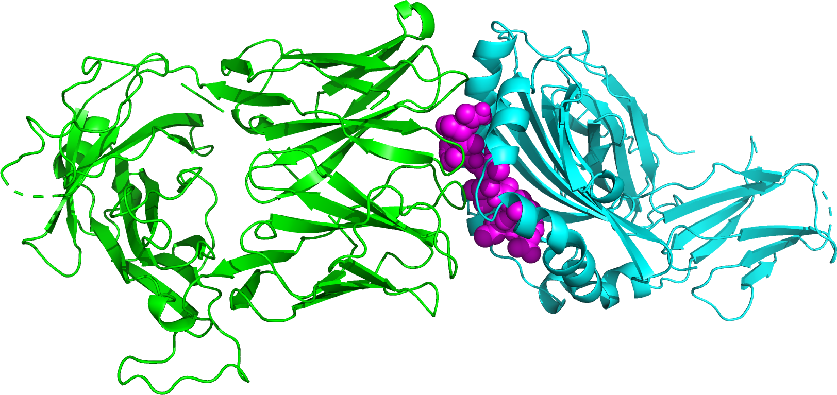

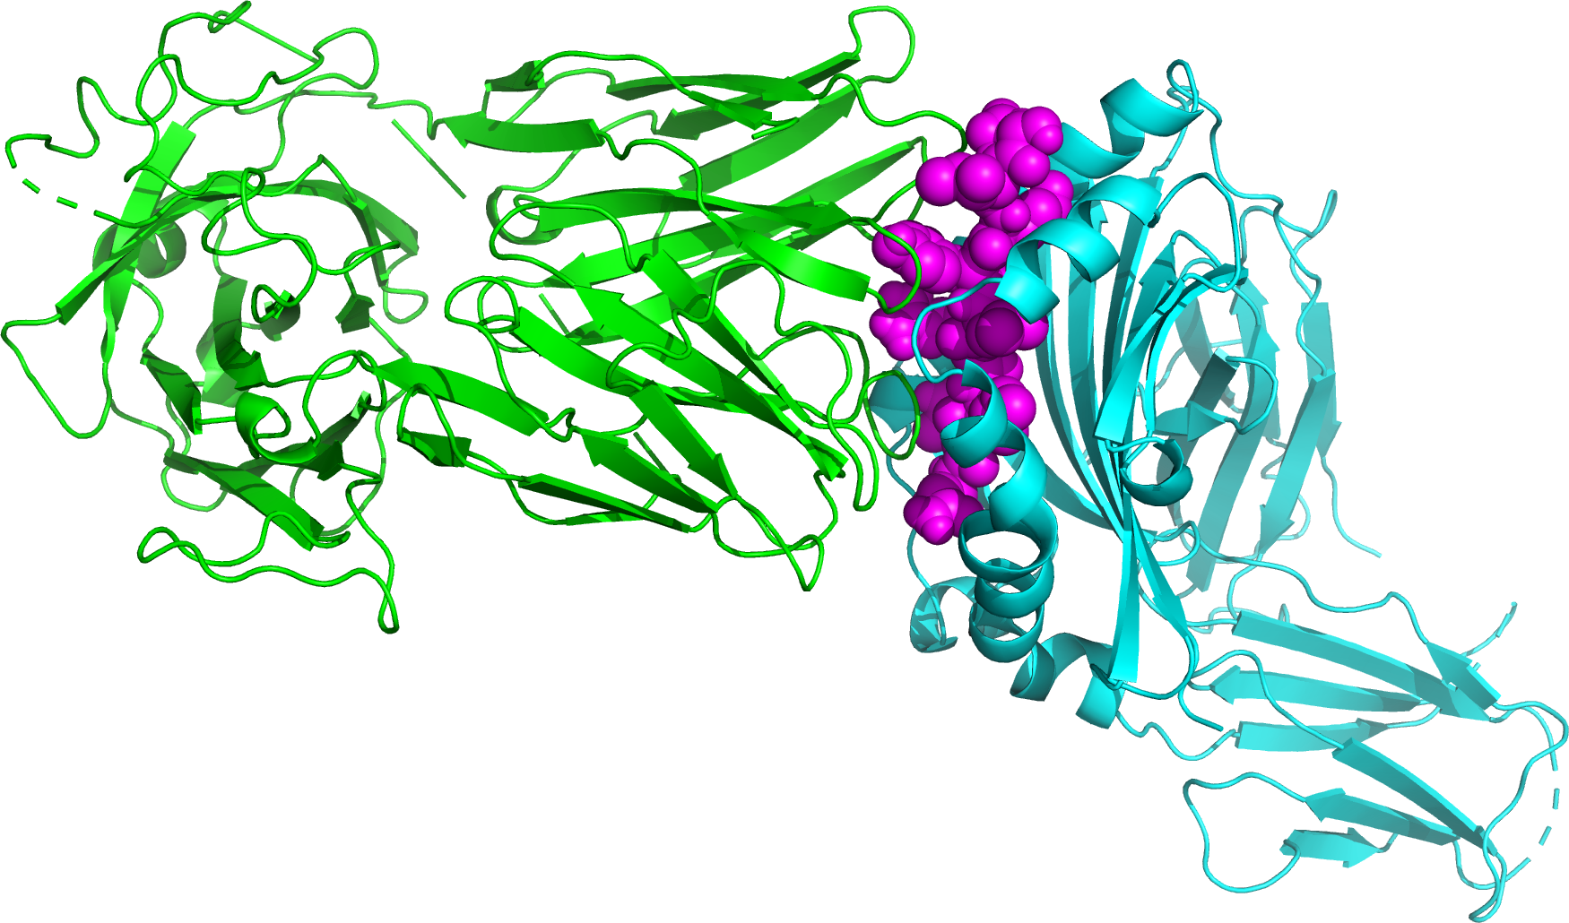

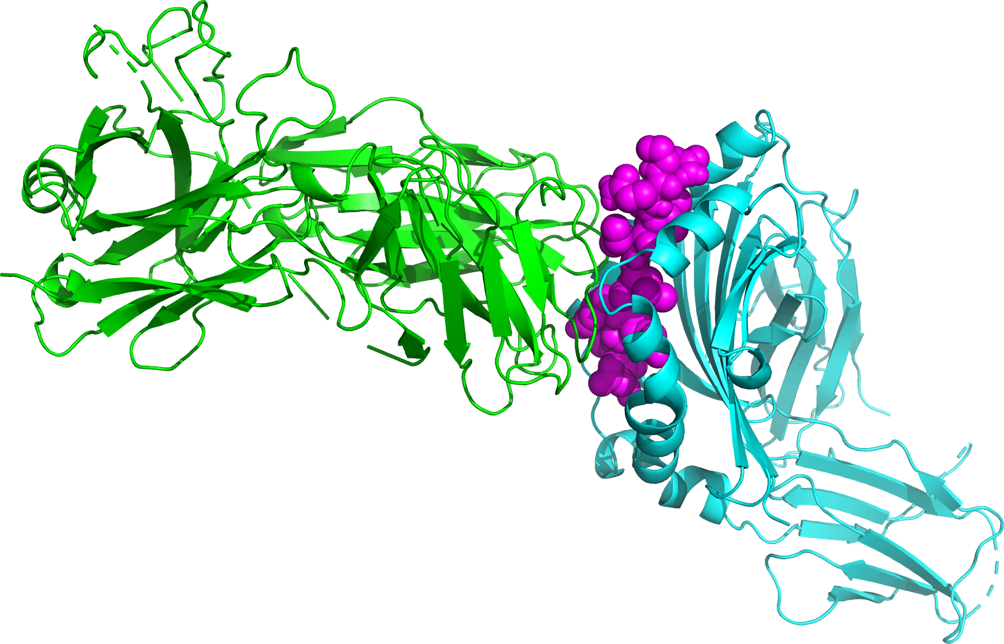
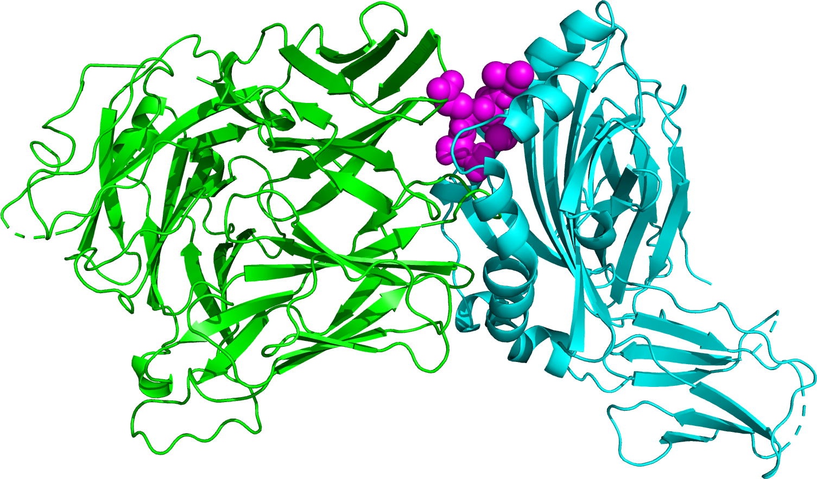
HLA-CSP peptide-TCR Complexes
CSP 3D7 Ref | CSP-1 | CSP-4 | CSP-7 | CSP-8 | CSP-12
CSP-15 | CSP-16 | CSP-19 | CSP-22 | CSP-32 | CSP-35
CSP-47 | CSP-55 | CSP-68 | CSP-94 | CSP-117 | Other Info: CD4+ T Cell HLA-2A Th2R Region

Slide 12
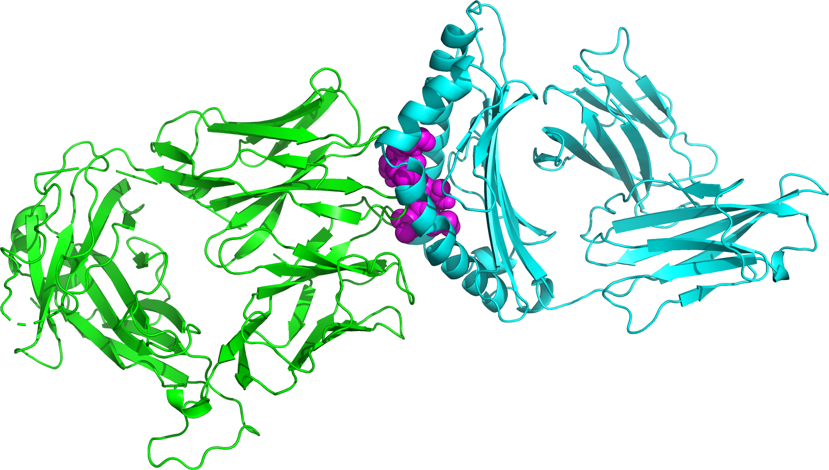
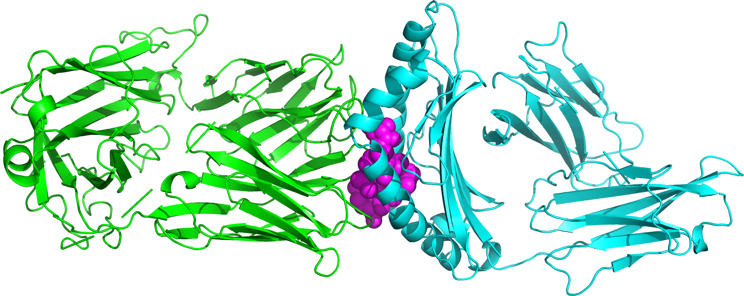
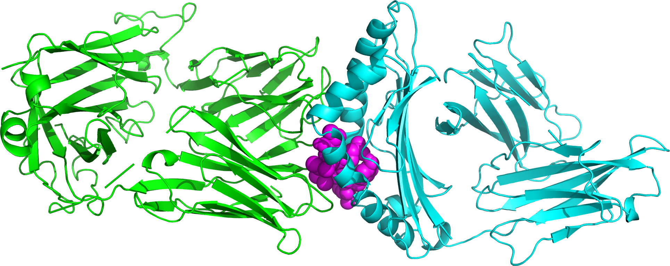
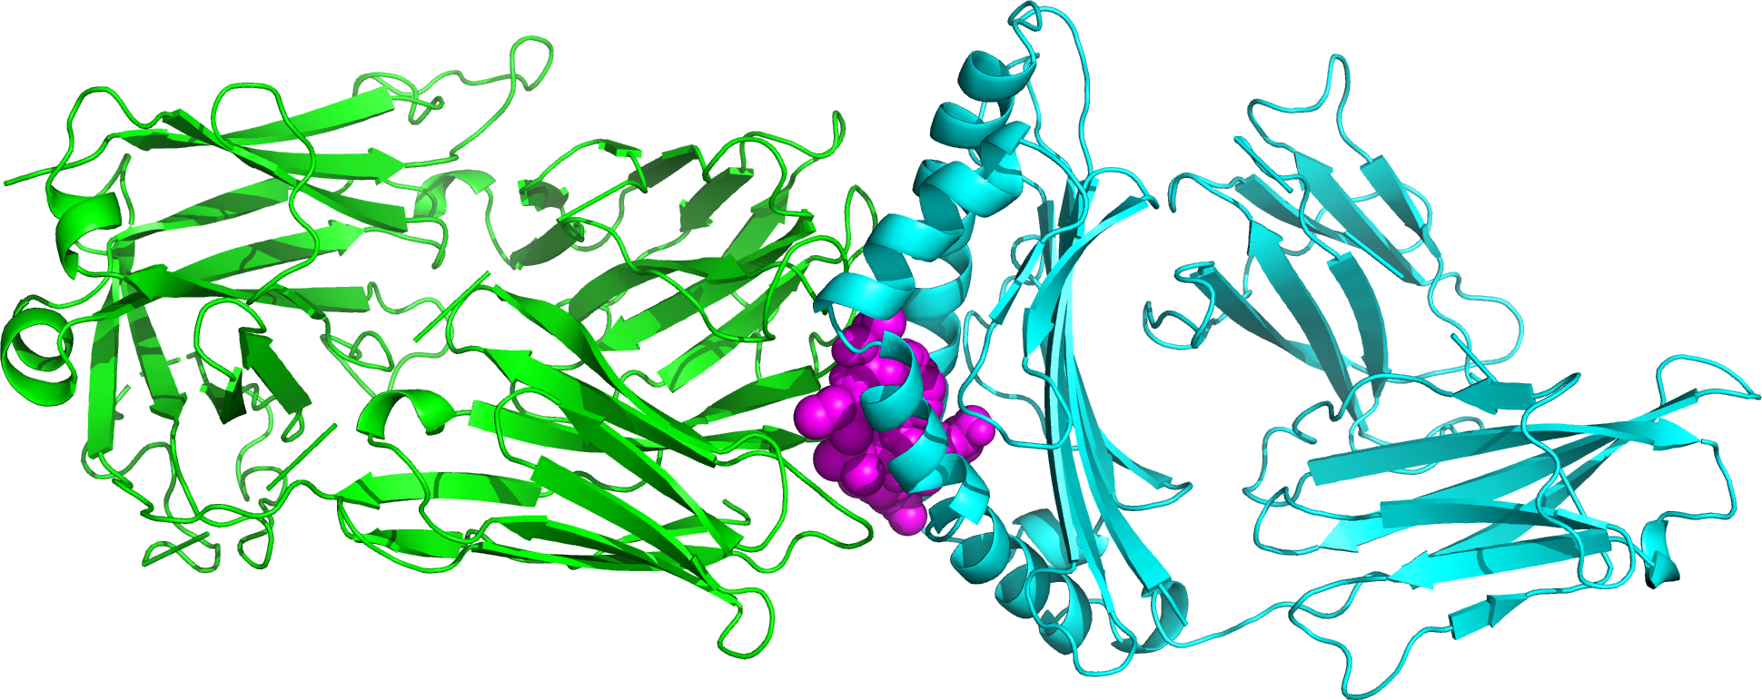
HLA-CSP peptide-TCR Complexes
CSP 3D7 Reference | CSP-1
CSP-4 | CSP-35
Other Info:
CD8+ T Cell
HLA-DRB1
Th3R Region

Slide 13
Docking Metrics

Slide 14
Structural Analysis of Antibody Binding in SARS-CoV-2

